Slide 1
EthiCars
Can autonomous vehicles make ethical decisions one day?
by Robert Juhasz, April 2021

Slide 2
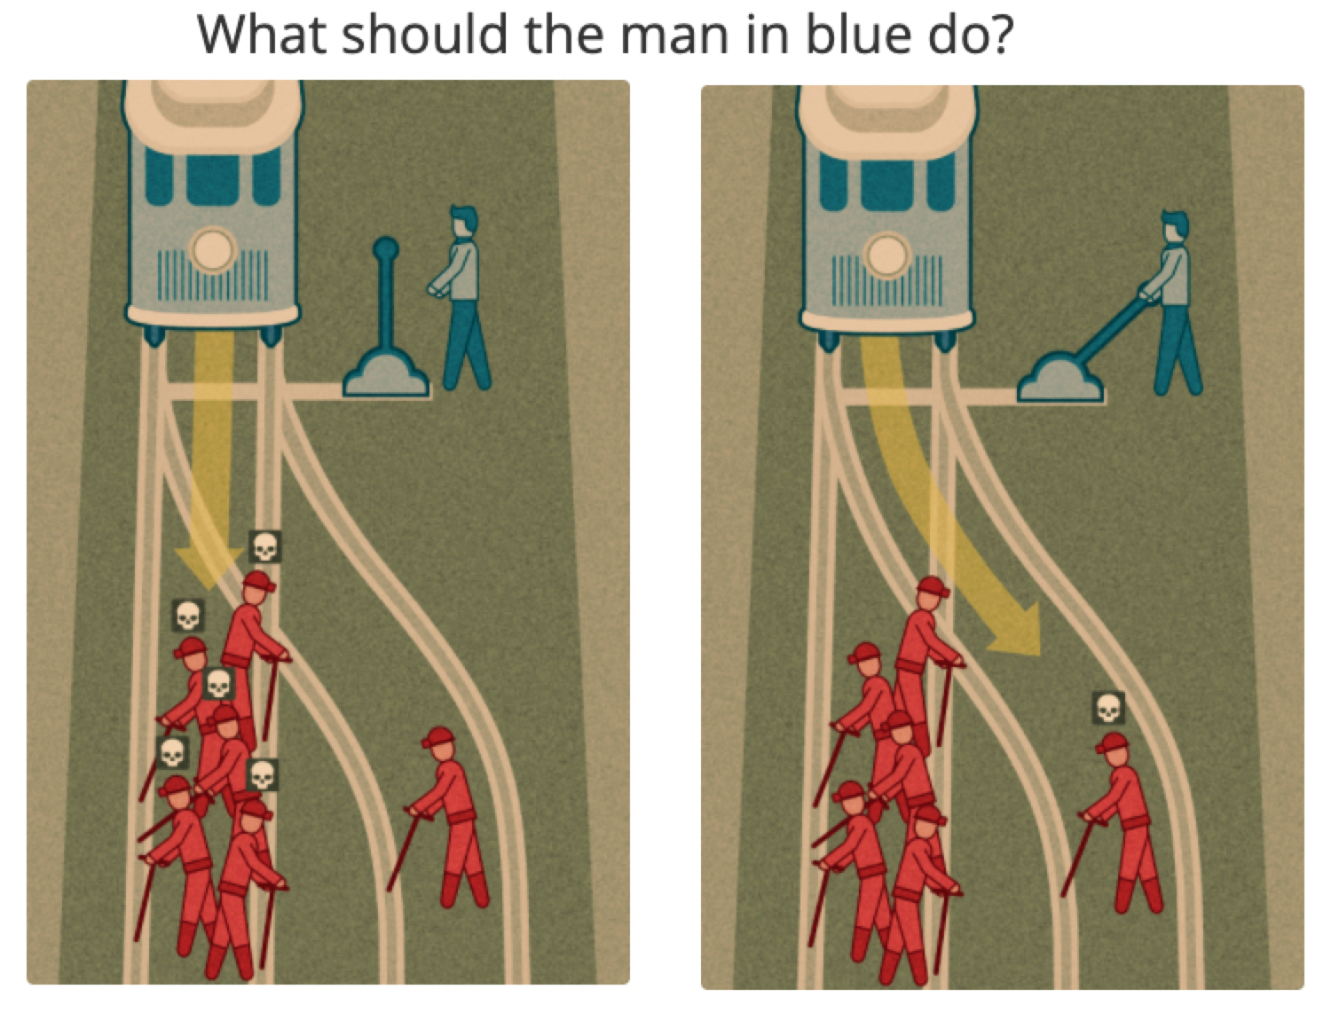
Moral Machine Project
An MIT crowd sourcing project
Collect human decisions in various scenarios
Two deadly outcomes in a car accident
Based on the old "trolley problem”
Ethical dilemma:
Sacrifice one person to save more.

Slide 3
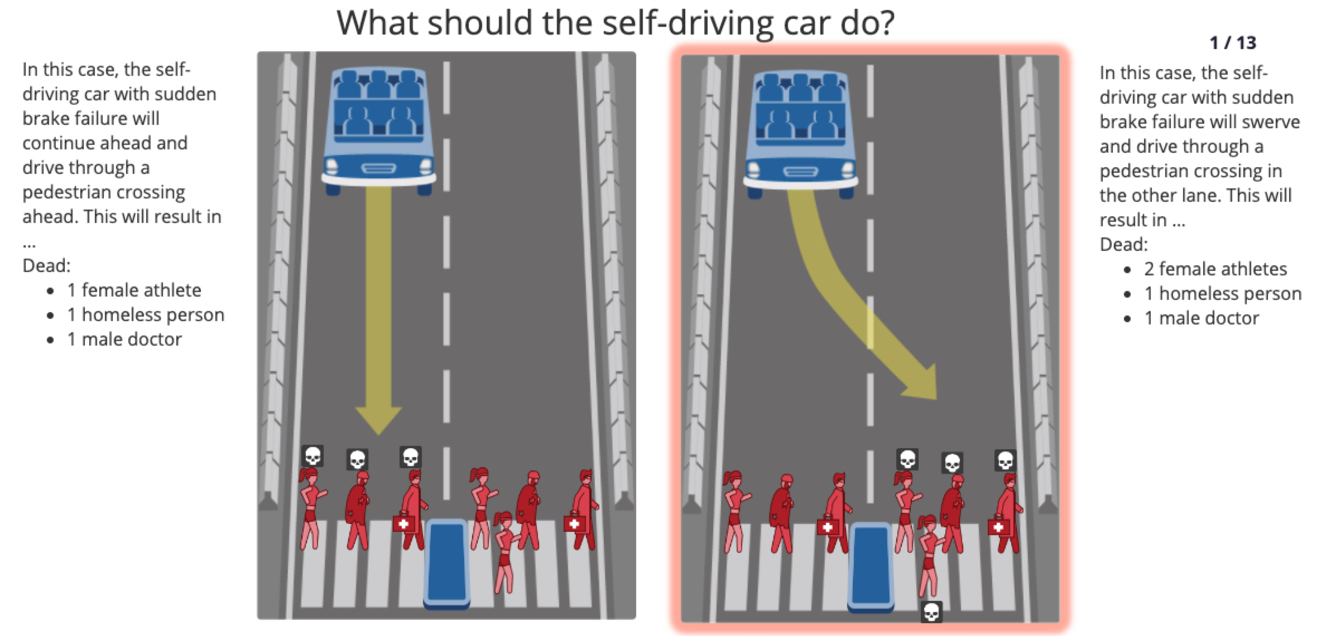
Moral Machine Project

Slide 4






The Data Pipeline
Moral Machine database
Downloaded from OSF
Main data in 2 CSV files
#1 | 70.3M rows | 11.6 GB
#2 | 11.3M rows | 1.83 GB
Additional external data with country information

Slide 5
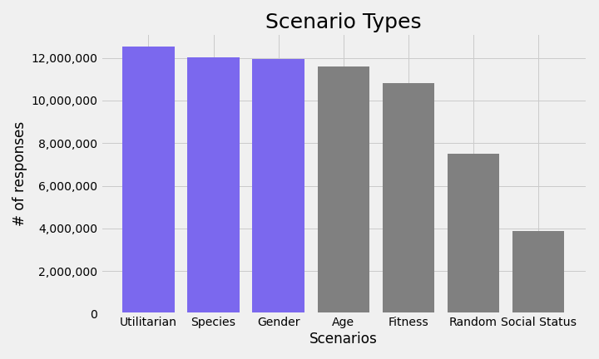
Exploratory Data analysis
Utilitarian less or more
Species humans vs animals (cats & dogs)
Gender man vs woman
Age young vs old
Fitness fit vs fat
Social Status doctor vs homeless person

Slide 6
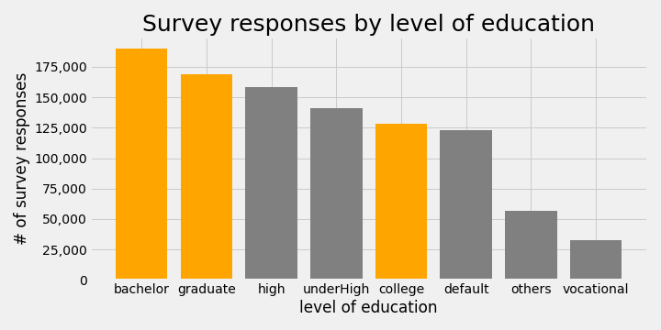
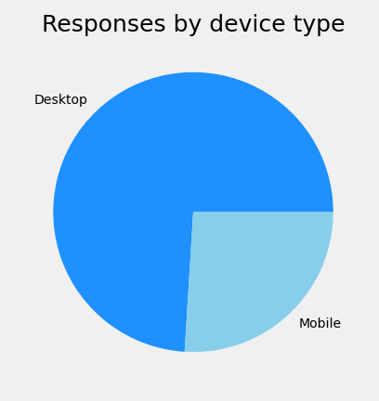
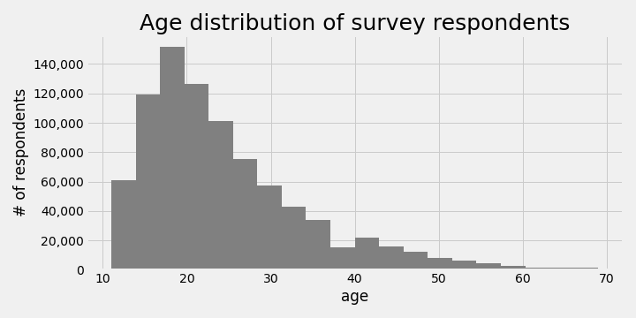
Exploratory Data analysis
College / university categories ranked highest
MIT probably advertised the project amongst other schools
Age distribution also has highest frequency amongst high-school to post graduate age groups
Had to filter out funny age responses (e.g. -92 or 80,000)
Mostly desktop (laptop) devices used in around ¾ of the surveys

Slide 7
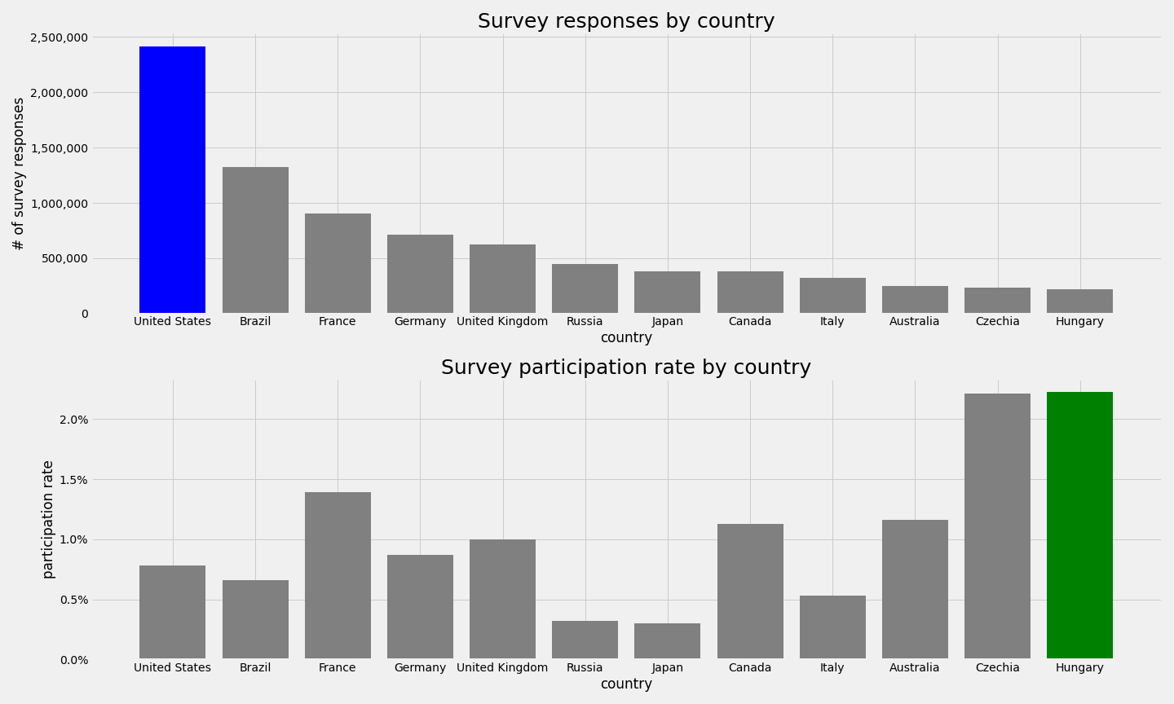
Exploratory Data analysis
United States had the most survey responses
Hungary ranked #12
Joined data with country info
Participation rate comparted to total population
Hungary came out #1 out of those 12 countries

Slide 8
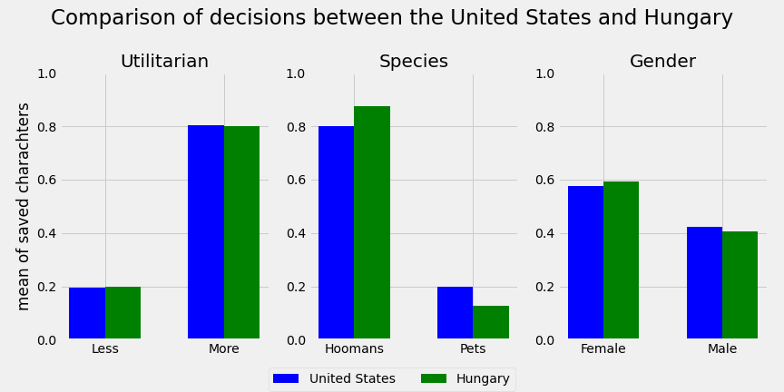
Who would you let die?
Compared responses from the U.S. (my new home) vs Hungary (my home country)
Only looked at 3 most frequent scenario types
Smaller dataset as Pandas DF
# of characters saved by a decision in a scenario
Very similar, but U.S. seems to choose pets over humans slightly more often than Hungary

Slide 9
Future Work
Can AVs gather enough information about their surroundings to optimize outcomes in a deadly accident?
Would people be willing to buy an AV or subscribe to a service that might choose to let them die vs. others on the road?
How are AVs going to change car insurance premiums for human drivers? Is driving going to become a luxury hobby one day?
The Moral Machine scenarios are overly simplistic. Is there a real possibility for an AI algorithm to understand all important factors in a given situation and can or should it make an ethical decision?

Slide 10

Contact Information
Name Robert Juhasz
e-mail robert.juhasz@gmail.com
LinkedIn https://www.linkedin.com/in/robert-juhasz-10bbb563/

